Slide 1
X
Y

Slide 2
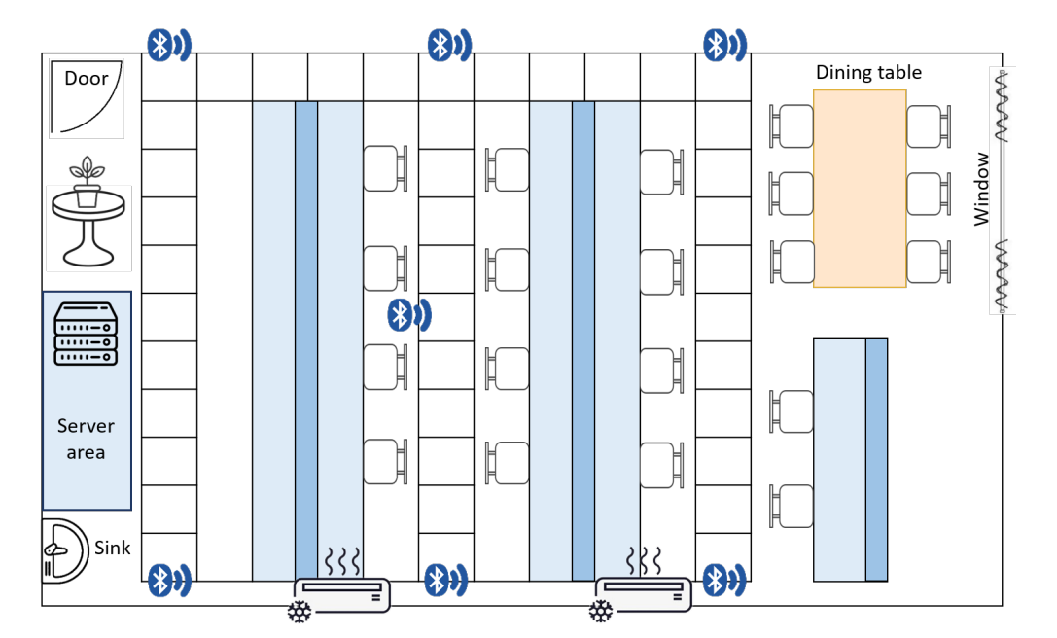
(5400,1100,1350)
(0,0)
X
(6000,1100)
(0,1100,1400)
(3810,2500,1600)
(530,2500,1500)
A
(6000,4100)
(0,4100,1400)
B
Y
C

Slide 4
